Slide 1

STUDENT NAME : DHINESH KUMAR A
REGISTER NO & NMID : 24131190500121006
&
15AA643CAB4EE5DA70D444E54FB7B06E
Department : BCA
College Code : ANU119
College Name : Government Arts and Science College Tittagudi – 606106
University Name : Annamalai University

Slide 2
PROJECT TITLE
Digital Portfolio

Slide 3


AGENDA
Problem Statement
Project Overview
End Users
Tools and Technologies
Portfolio design and Layout
Features and Functionality
Results and Screenshots
Conclusion
Github Link
3/21/2024 Annual Review

Slide 4

PROBLEM STATEMENT
Definition:
A digital portfolio is an online collection of work that showcases your skills, experiences, and accomplishments. It can include various media types such as text, images, videos, and links.

Slide 5

PROJECT OVERVIEW
1.Project Title
2.Project Description
3.Your Role
4.Objectives and Goals
5.Tools and Technologies Used
6.Challenges Faced
7.Solutions Implemented
8.Results and Outcomes

Slide 6

WHO ARE THE END USERS?
1. Potential Employers
2. Clients
3. Collaborators
4. Industry Peers
5. Educational Institutions
6. General Public
7. Investors or Stakeholders
8. Recruitment Platforms

Slide 7

TOOLS AND TECHNIQUES
1.Website Builders
2.Design Tools
3.Code Editors
4.Version Control
5.Project Management Tools
6.Analytics Tools
7.Content Management Systems (CMS)

Slide 8
POTFOLIO DESIGN AND LAYOUT
1. Choose a Clean and Professional Design
2. Typography
3. Layout Structure
4. Navigation
5. Project Presentation
6. Visual Elements
7. Responsive Design
8. Call to Action (CTA)
9. Testimonials and Endorsements
10. Regular Updates
8

Slide 9
FEATURES AND FUNCTIONALITY
1.Responsive Design
2.User -Friendly Navigation
3.Project Showcase
4.Search Functionality
5.Contact Form
6.Social Media Integration
7.Downloadable Resume
8.Testimonials and Endorsements

Slide 10
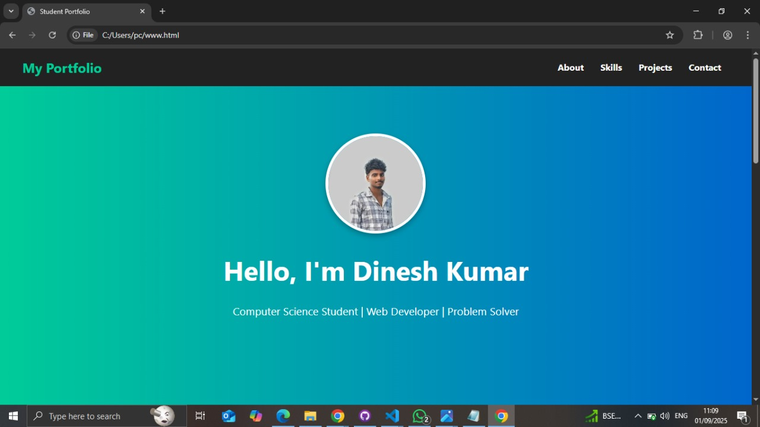

RESULTS AND SCREENSHOTS
3/21/2024 Annual Review
10

Slide 11
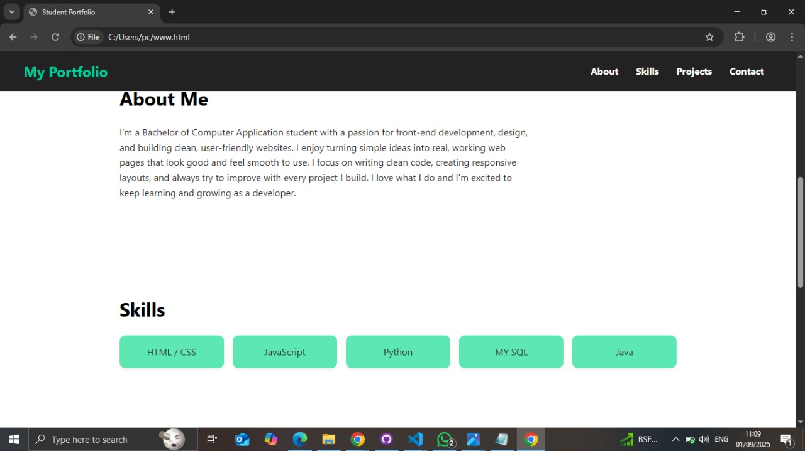
RESULTS AND SCREENSHOTS
3/21/2024 Annual Review
11

Slide 12
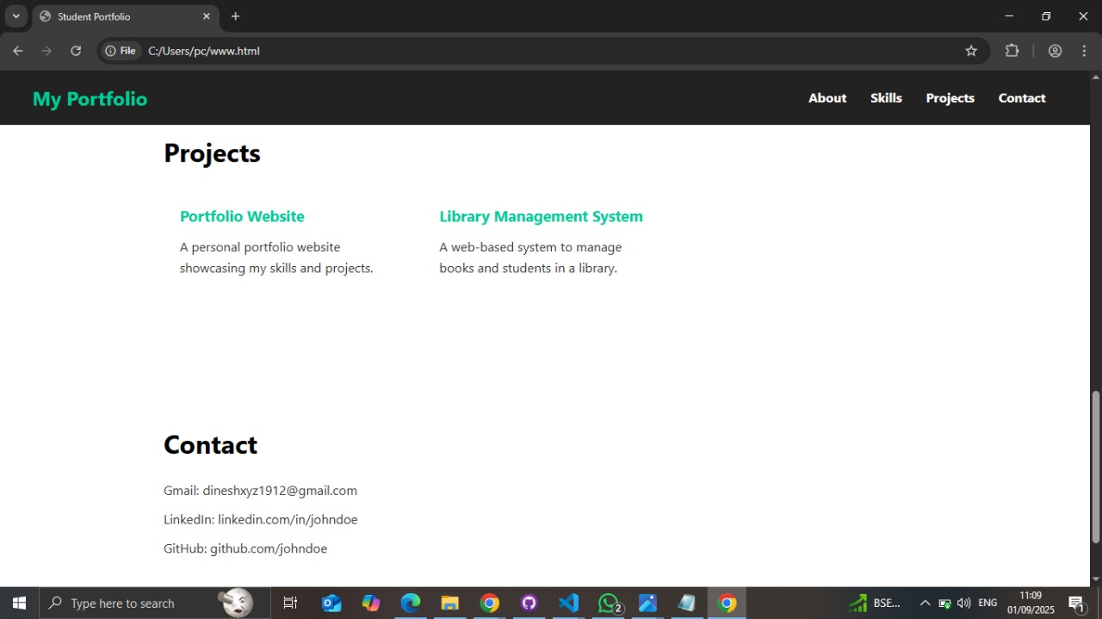
RESULTS AND SCREENSHOTS
3/21/2024 Annual Review
12

Slide 13
CONCLUSION
Creating a digital portfolio is an essential step for professionals and creatives looking to showcase their skills, experiences, and projects in a compelling way. A well-designed portfolio not only highlights your work but also serves as a powerful tool for personal branding and networking. Here are some key takeaways for concluding your digital portfolio:
13

Slide 14
Github Link
https://github.com/dinesh9626/Dinesh-kumar-TNSDC-FWD-DP.git

